Slide 1
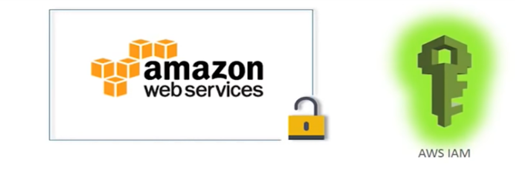
Identity & ACCESS MANAGEMENT (IAM)
Vikas

Slide 2
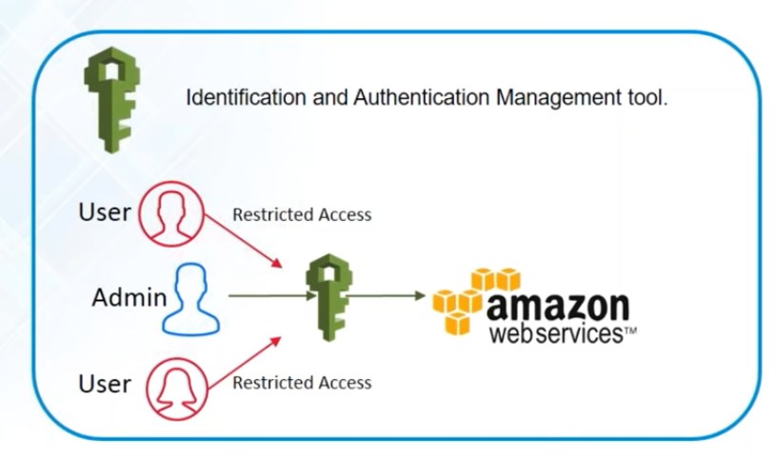
Notes:
You may be aware but lets get started from here .

Slide 3
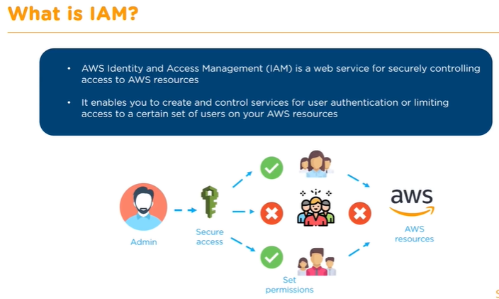
Notes:
IAM allows you to manage users and their level of access to the AWS console .
The reason for this issue is that IAM users are created with no permissions by default. That means that when you created the new IAM user, you might not provisioned any permissions to the user.
The IAM user might need to make API calls or use the AWS CLI or the Tools for Windows PowerShell. In that case, create an access key (an access key ID and a secret access key) for that user. This is called Programmatic access.
If the user needs to access AWS resources from the AWS Management Console, create a password and provide it to the user.
Uses:
1. Centralised control
2. Shared access to AWS Account
3. Granluer acces
4. Identity Federation

Slide 4
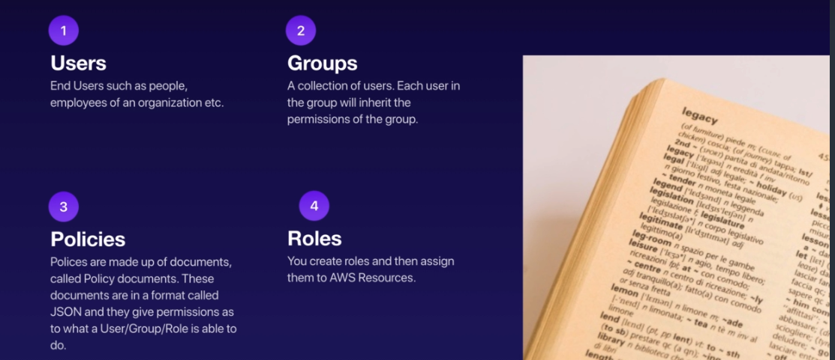
Key Terminologies :
Notes:
Power user : Provides full access to AWS services and resources, but does not allow management of Users and groups.
IAM => Here you a have a sign in link which can be sent to user which can be customized => activate MFA login to root account(This can be done by virtual authenticator ) => Create Individual IAM user -> mange user -> add user -> select AWS access type (Programmatic access (access key id +secret access key )+AWS Management console access ) => Set Permission => create a group => add user to the group => create user ➔ manage password policy

Slide 5
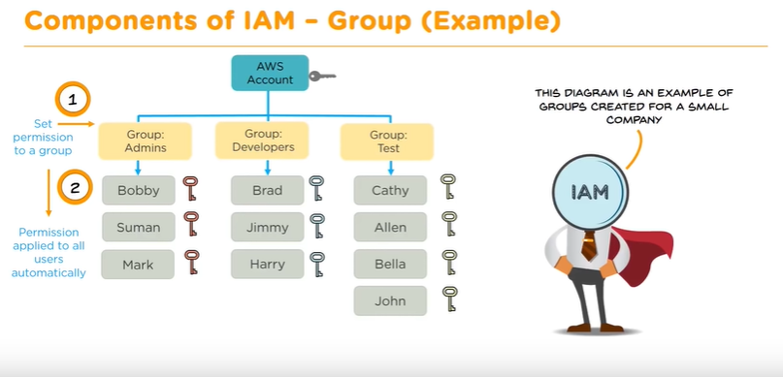
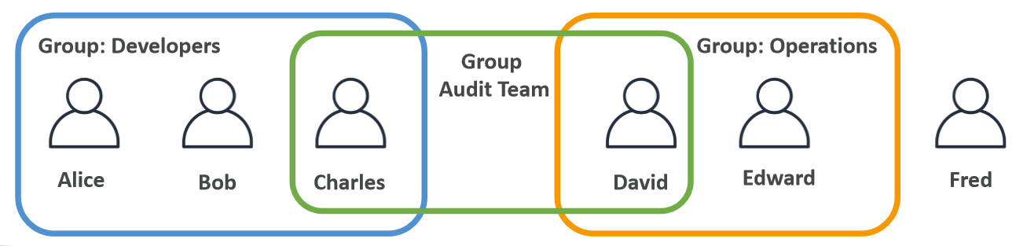
Notes:
IAM Users
=========
An IAM user is an entity that represents a person or service It can be assigned an access key ID and secret access key for programmatic access to the AWS API,CLI, SDK, and other development tools
The account root user credentials are the email address used to create the account and a password and has full administrative permissions and these cannot be restricted
Enable Multi-Factor Authentication (MFA)
IAM users can be created to represent applications,
and these are known as “service accounts”
You can have up to 5000 users per AWS account
Each user account has a friendly name and an Amazon Resource Name (ARN) which uniquely identifies the user across AWS
You should create individual IAM accounts for users (best practice not to share accounts)
A password policy can be defined for enforcing password length, complexity etc.(applies to all users)
IAM Groups
==========
Groups are collections of users and have policies attached to them
A group is not an identity and cannot be identified as a principal in an IAM policy
Use groups to assign permissions to users
Use the principal of least privilege when assigning permissions
You cannot nest groups (groups within groups)
IAM Roles
=========
Roles are created and then “assumed” by trusted entities and define a set of permissions for making AWS service requests
With IAM Roles you can delegate permissions to resources for users and services without using permanent credentials (e.g. user name and password)
IAM users or AWS services can assume a role to obtain temporary security credentials that can be used to make AWS API calls
You can delegate using roles
There are no credentials associated with a role (password or access keys)
IAM Policies
============
Policies are documents that define permissions and can be applied to users, groups and roles
Policy documents are written in JSON (key value pair that consists of an attribute and a value)
All permissions are implicitly denied by default and The most restrictive policy is applied
The IAM policy simulator is a tool to help you understand, test, and validate the effects of access control policies
The Condition element can be used to apply further conditional logic

Slide 6


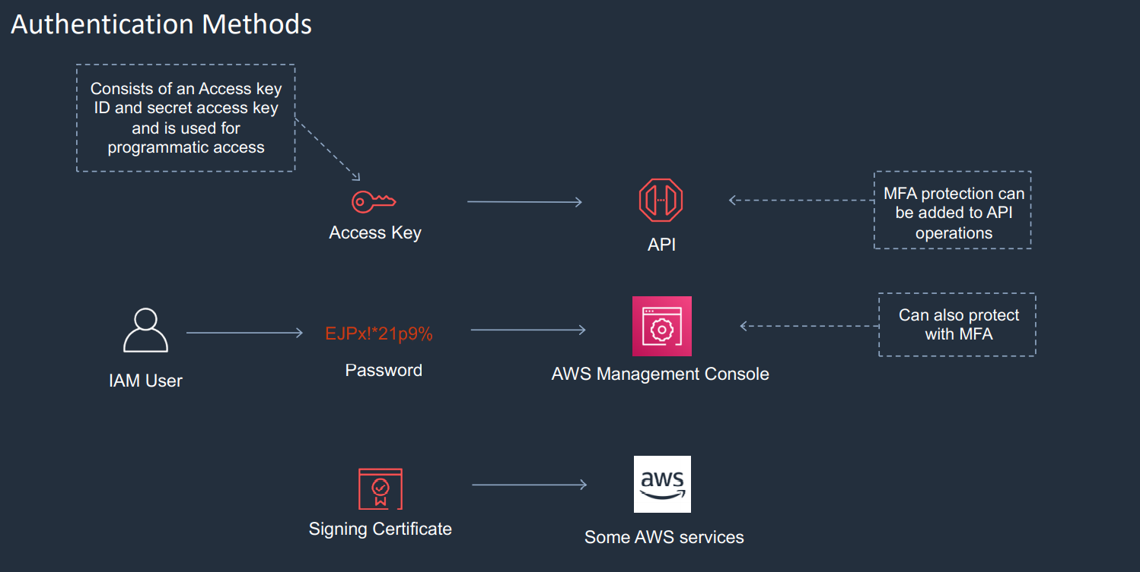
Notes:
Least Privilege policy

Slide 7
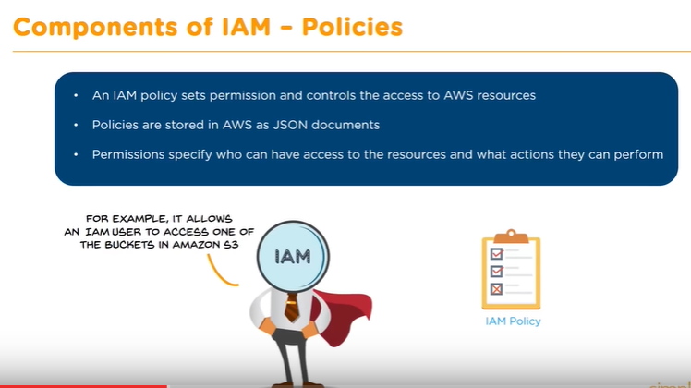

Slide 8
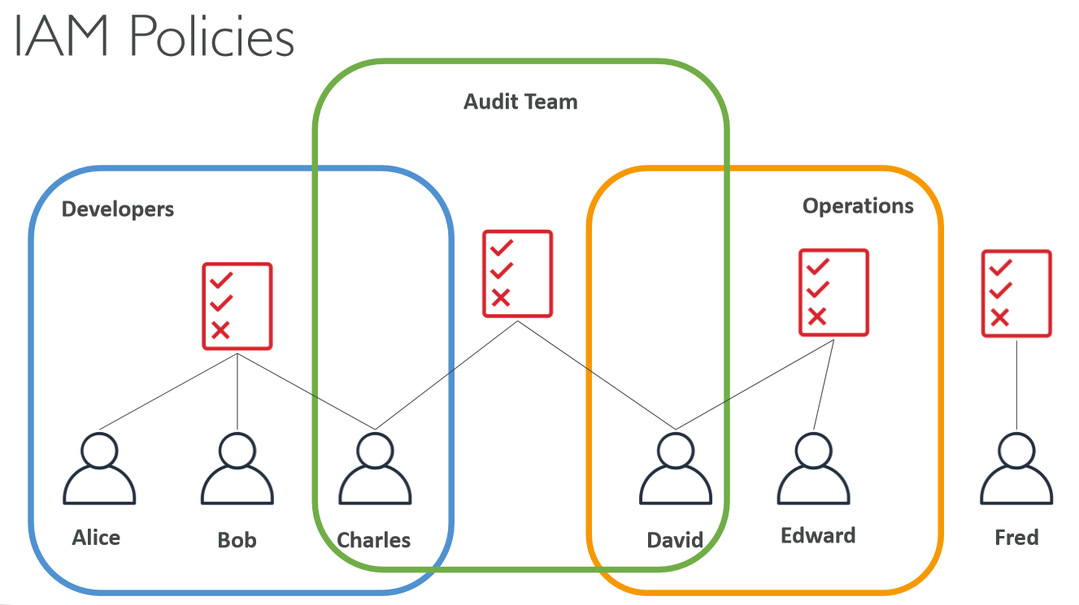

Slide 9
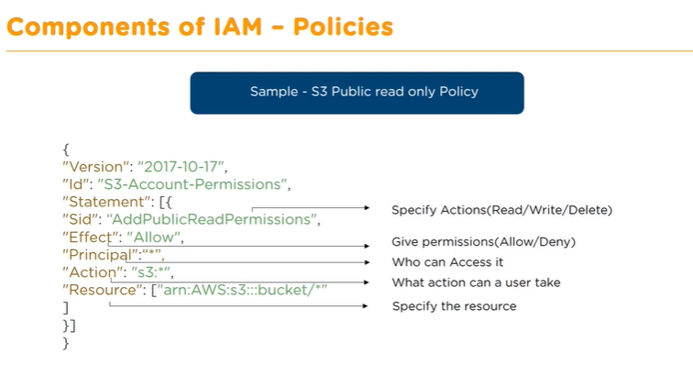
Notes:
Bucket policy to allow only users with MFA validation to enter sub folder .
Create bucket and then the si=ub folder
Create two users with s3 full access but add MFA validation for one of them .

Slide 10
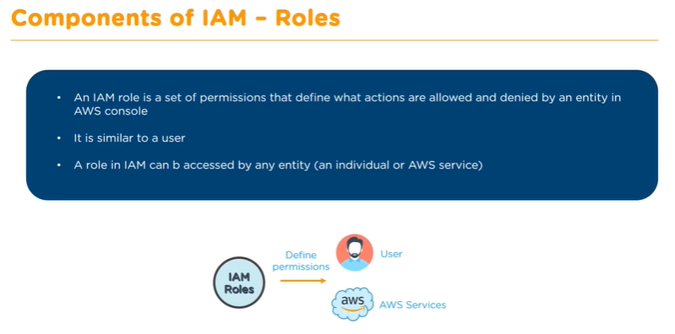
Notes:
Difference between user and role .
User permissions are hard coded whereas roles permission are accessible to any entity .Role permissions are temporary whereas user permissions are permanent .
IAM Security Tools
• IAM Credentials Report (account-level)
• a report that lists all your account's users and the status of their various credentials
• IAM Access Advisor (user-level)
• Access advisor shows the service permissions granted to a user and when those services were last accessed. • You can use this information to revise your policies.
Audit permissions of your account with the IAM Credentials Report

Slide 11
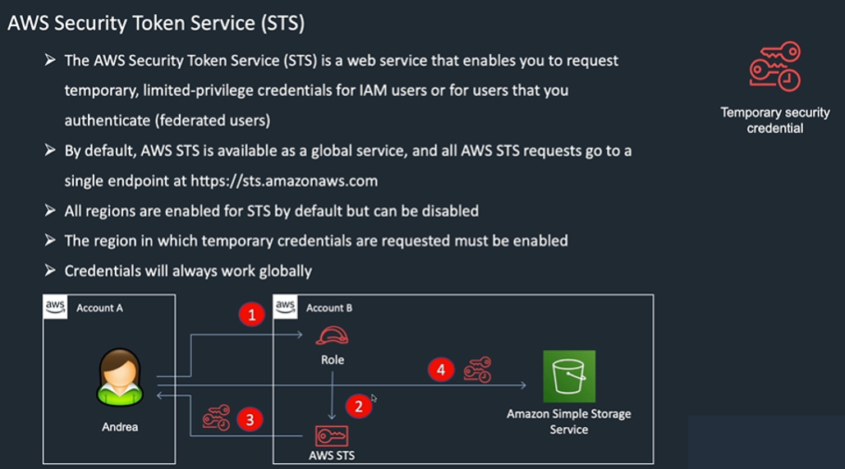

Slide 12
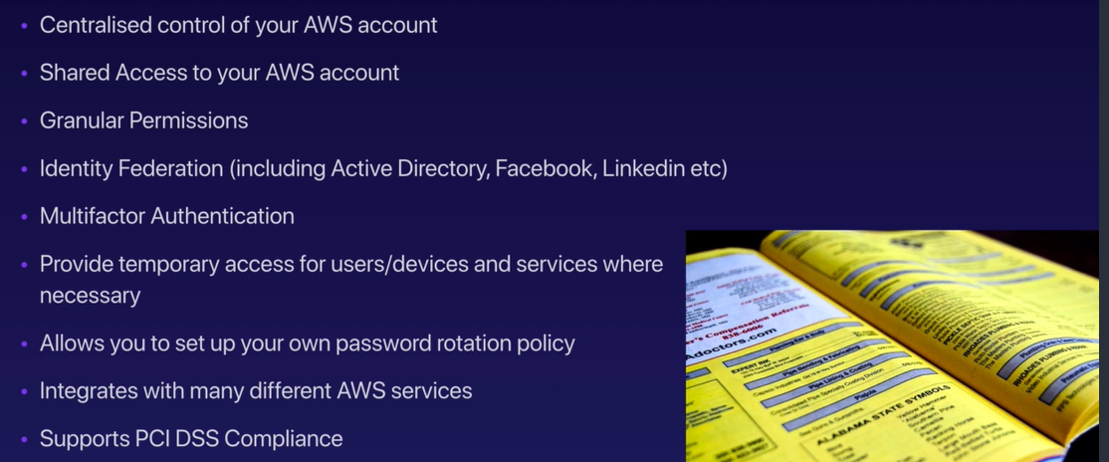
Services offered by IAM :
Notes:
IAM Guidelines & Best Practices
• Don’t use the root account except for AWS account setup
• One physical user = One AWS user
• Assign users to groupsand assign permissions to groups
• Create a strong password policy
• Use and enforce the use of Multi Factor Authentication (MFA)
• Create and use Rolesfor giving permissions to AWS services
• Use Access Keys for Programmatic Access (CLI / SDK)
• Audit permissions of your account with the IAM Credentials Report
• Never share IAM users & Access Keys

Slide 13

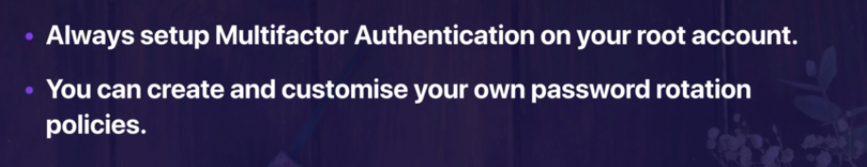
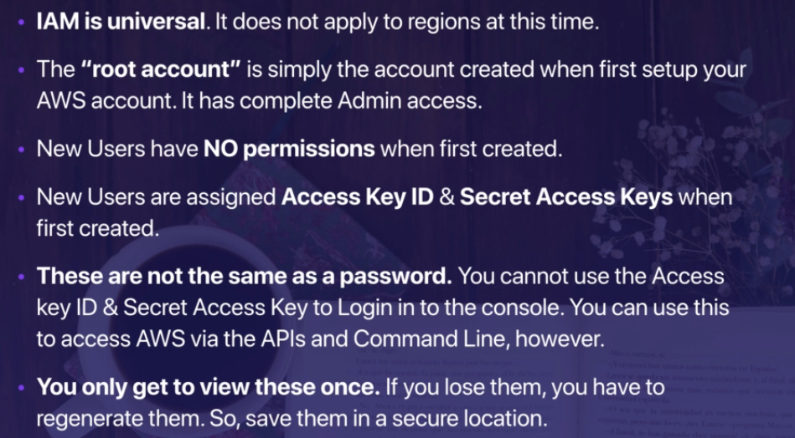
IAM Important points :
Notes:
If you provide role the you need not share login credentials .
Moreover if one login has 100 instances and by mistake any one of them get compromised you need not bother for others .

Slide 14
AWS STS – Security Token Service
• Allows to grant limited and temporary access to AWS resources.
• Token is valid for up to one hour (must be refreshed)
• Assume Role
• Within your own account: for enhanced security
• Cross Account Access: assume role in target account to perform actions there
• Assume Role With SAML
• return credentials for users logged with SAML
• Assume Role With Web Identity
• return creds for users logged with an IdP (Facebook Login, Google Login, OIDC compatible…)
• AWS recommends against using this, and using Cognito instead
• Get Session Token
• for MFA, from a user or AWS account root user
Notes:
Create a IAM role -- > Define principles which can access this role -- > use AWS STS -- > Credentials available for 15 mins to 1 hour .
https://docs.aws.amazon.com/IAM/latest/UserGuide/id_roles_common-scenarios_aws-accounts.html
https://docs.aws.amazon.com/IAM/latest/UserGuide/id_roles_providers_saml.html
https://docs.aws.amazon.com/IAM/latest/UserGuide/id_roles_providers_enable-console-saml.html
Federation – External source of truth for validation [User Management is outside AWS ]. So, we need that trusted third party source .Eg : SAML2.0
MS AD – s/w on windows server with AD Domain service .DB for all users
Directory service --
AWS Managed MS AD – Supports MFA
Simple AD – Standalone
AD Connector – proxy connector
Amazon Cognito User pools
Questions like – cross account or assuming role .

Slide 15
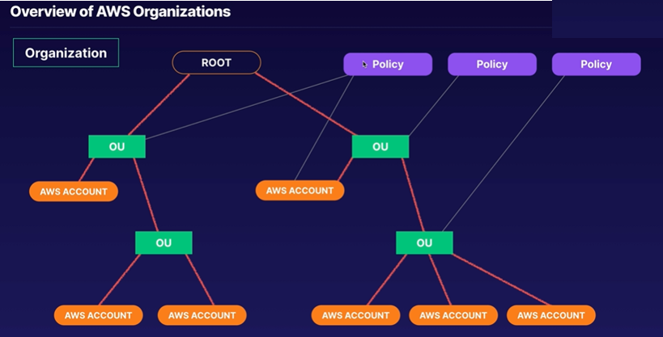
Notes:
Organisational account (OU)
cognito - authentication via web and mobile apps
user pool -user directory , Federation
identity pool - temporary access for aws services
KMS
AWS Managed keys
Customer Managed Keys
HSM - Hardware security Module - hardware device to store encryption keys (regulatory + corporate contractual ) - AWS proprietry + no upfront payment + pay per hour
WAF and sheild :
DDos - Distributed denial service - In computing, a denial-of-service attack is a cyber-attack in which the perpetrator seeks to make a machine or network resource unavailable to its intended users by temporarily or indefinitely disrupting services of a host connected to the Internet

Slide 16
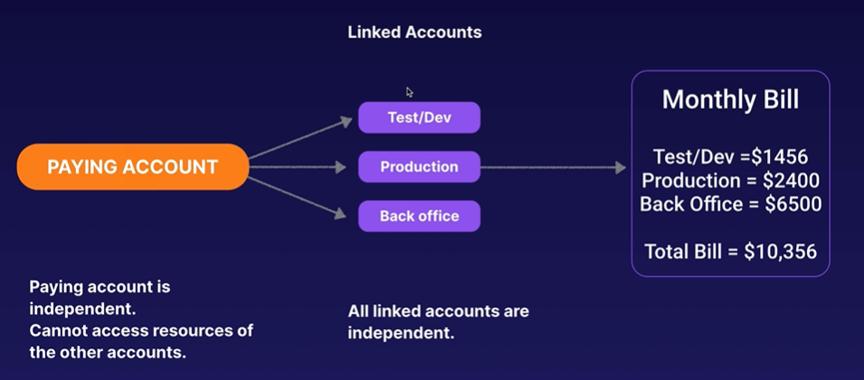

Slide 17
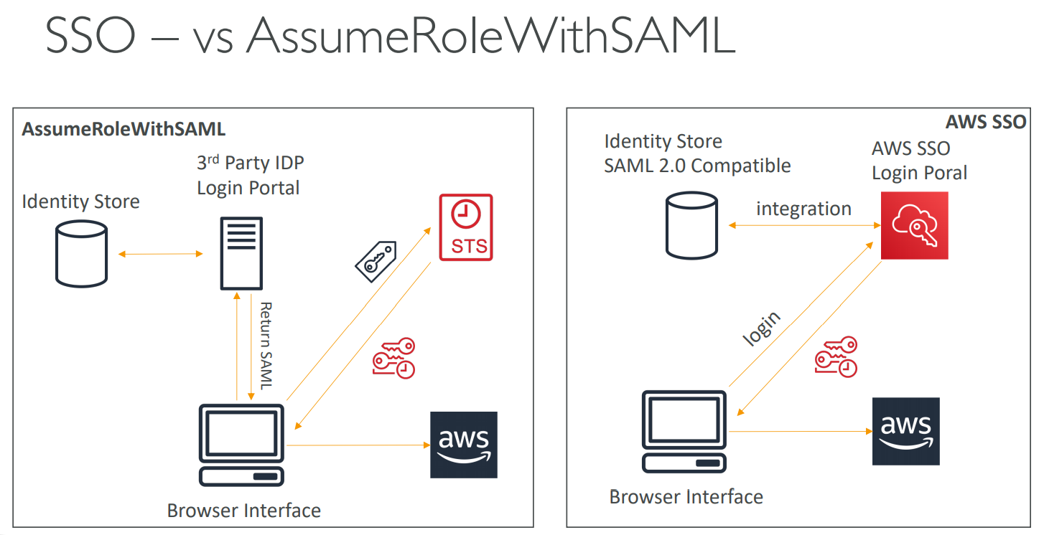
Notes:
AWS SSO : (https://aws.amazon.com/blogs/security/introducing-aws-single-sign-on/)
-----------
Mange multiple accounts and third-party applications .
AWS Single Sign on -

Slide 18
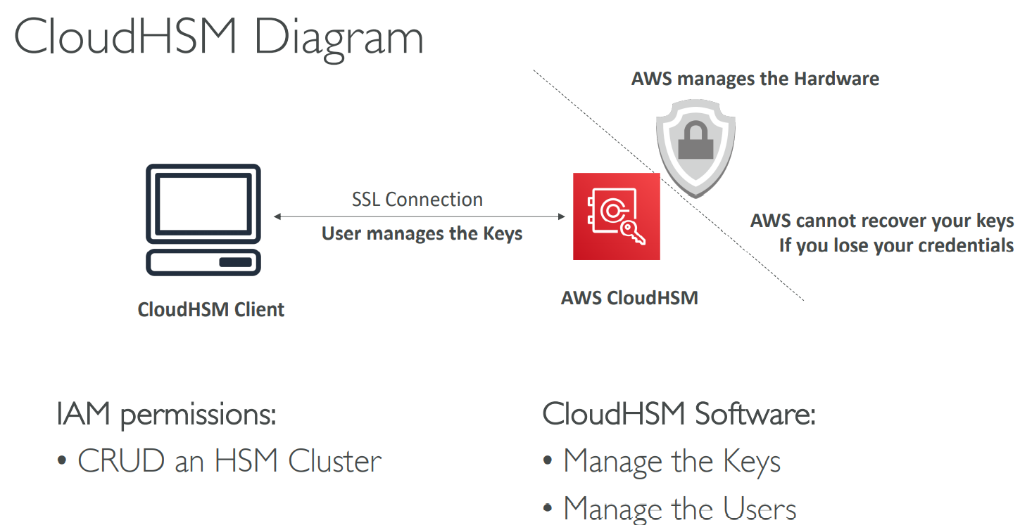
Notes:
Cloud HSM (Hardware Security Module) is a way of encryption .
AWS - KMS manages the software for encryption but Cloud HSM just provisions encryption Dedicated Hardware and You manage your own encryption keys entirely (not AWS) .
• HSM device is tamper resistant, FIPS 140-2 Level 3 compliance – No one even in AWS can touch your h/w .
• CloudHSM clusters are spread across Multi AZ (HA) – must setup
• No free tier available
• Must use the CloudHSM Client Software
• Redshift supports CloudHSM for database encryption and key management
• Good option to use with SSE-C encryption

Slide 19
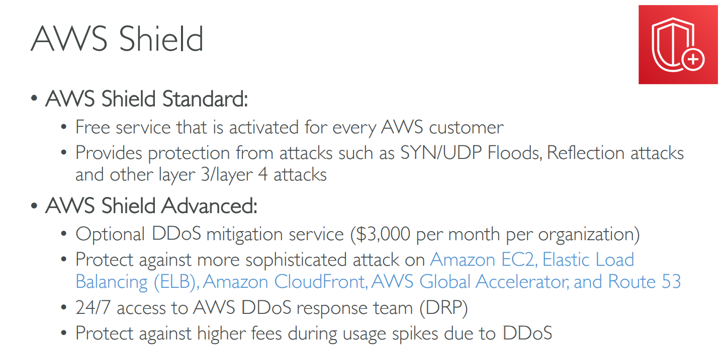
Notes:
Ddos attack - https://www.csoonline.com/article/3222095/ddos-explained-how-denial-of-service-attacks-are-evolving.html
https://www.cloudflare.com/learning/ddos/syn-flood-ddos-attack/
https://www.cloudflare.com/learning/ddos/udp-flood-ddos-attack/
https://www.cloudbric.com/blog/2015/03/reflection-attacks-and-amplification-atttacks/#:~:text=Reflection%20attacks%20(also%20known%20as,to%20that%20type%20of%20request.
https://d1.awsstatic.com/whitepapers/Security/DDoS_White_Paper.pdf
$3000 per month .
AWS Guard Duty
------------------–
Intelligent and Cloud scale managed threat detection service . Helps to manage any threat to your application .
Continuously does security monitoring service where it analyses and processes VPC Flow logs ,AWS cloud event trail logs and DNS logs .
Flashes unexpected and potentially malicious activity on your AWS environment .

Slide 20
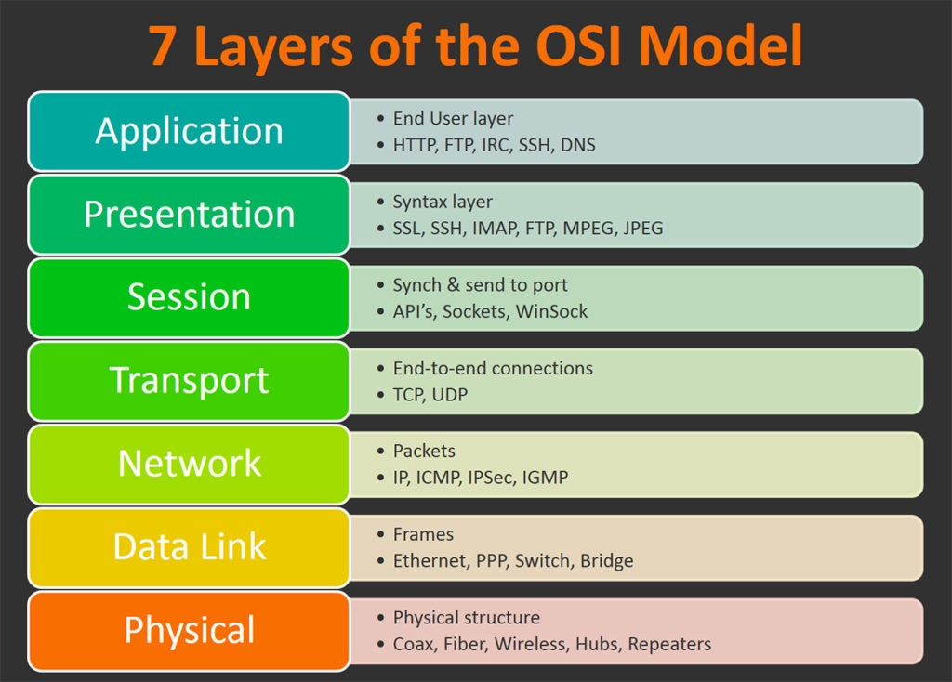

Slide 21
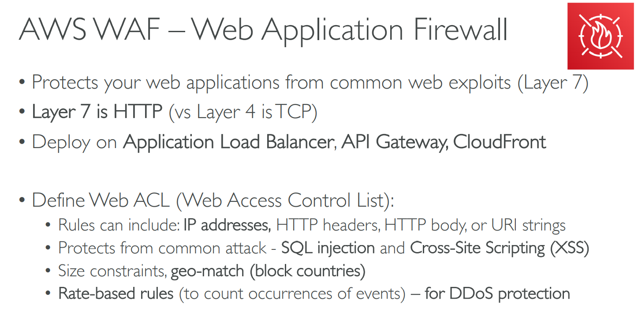
Notes:
Where can you deploy WAF ?
Not included in free Tier .
AWS Firewall Manager
-------------------------
• Manage rules in all accounts of an AWS Organization
• Common set of security rules
• WAF rules (Application Load Balancer, API Gateways, CloudFront)
• AWS Shield Advanced (ALB, CLB, Elastic IP, CloudFront)
• Security Groups for EC2 and ENI resources in VP
AWS Config - console
Cognito – Managed service which provides authentication , authorization and user management for web and mobile application.
- Provides enhanced security
- Cross platform consistency
- Guest and social media logins
- MFA & password policy
- Marketing analysis
Two major components :
User pool – Directory for sign in and signup choices for application users.
Identity Pool – Grant access to other AWS services .Can be either used separately or together with user pool.

